Slide 1
SBP : Presentation Outline
1

Slide 2
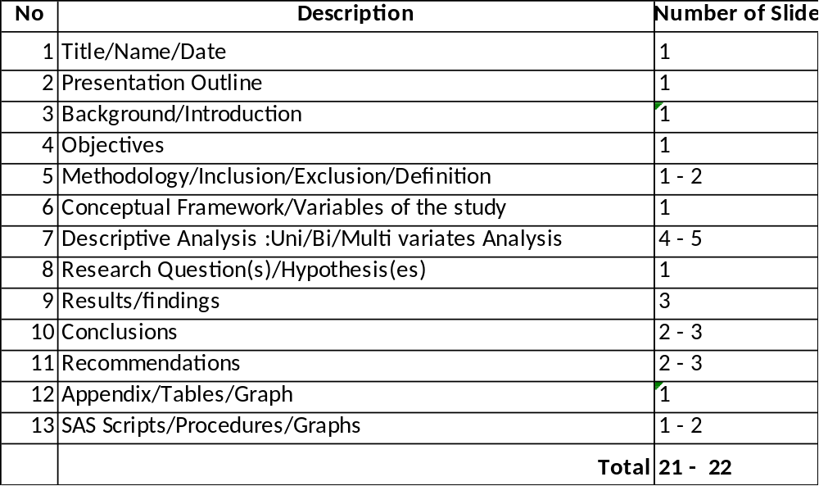
SBP : Presentation Outline

Slide 3
Title/Name/Date : 1 slide
Title : title of your project
Name : Your name
Data : Presentation Date

Slide 4
Presentation Outline : 1 slide
Background/Introduction
Objectives
Methodology
Conceptual Framework/Variables of the study
Descriptive Analysis
Research Question(s)/Hypothesis(Inferential/Predictive)
Results/findings
Conclusions
Recommendations
Appendix

Slide 5
Background/Introduction : 1 slide
Describe your project data
How many observations
How many variables (numeric and characters)
When the data was collected
Data Source (primary or secondary)

Slide 6
Objectives : 1 slide
Specify your objectives for this project
At least 2-3 objectives

Slide 7
Methodology : 1-2 slide
Data Collection if any
Data cleansing/Validation
Inclusions
Exclusions
Statistic Procedures/Software Version

Slide 8
Methodology : 1-2 slide
Business Rules for Data Cleaning / Selection :Example
  Continuous variables: Missing data replaced with mean value.
  Categorical variables: Missing data replaced with most popular value.

Slide 9
Conceptual Framework : 1-2 slide
Or variables of study
Independent Variables
Dependent Variables(Outcome)
Can have more than one conceptual framework

Slide 10
Conceptual Framework : Project 4
Independent Variables
Dependent Variable
Age
Income
Education
Credit score
Home Owner
Other Variables

Slide 11

Conceptual Framework : Project 4
Independent Variables:
Dependent Variables:
ATM Withdrawal Amounts
Retirement Acct
Branch of Bank
Credit Scores
Incomes

Slide 12
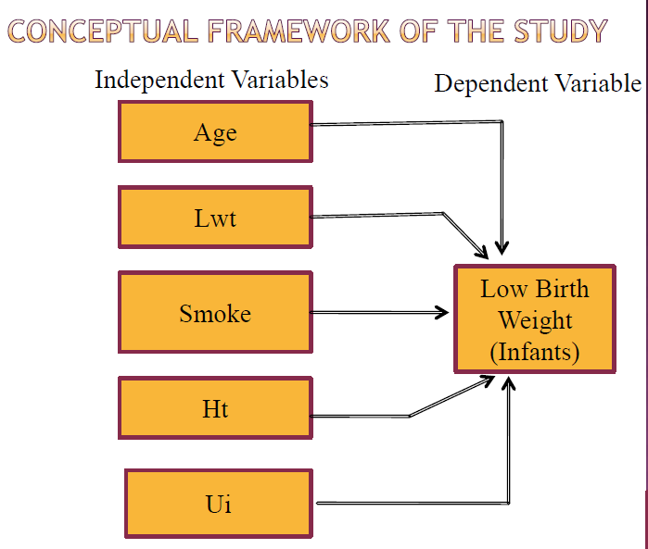
Conceptual Framework : Project 3

Slide 13
Conceptual Framework : 1-2 slide
Definitions
Independent Variables
Age Group
Income Group
Education level
Home Owner Status
…….
Definitions
Dependent Variables
Credit Score

Slide 14
Descriptive Analysis : 4-5 slide
Dependent Variable(s)
Grouping/Regrouping of variable
E.g. Credit Score -----Credit Score Group
Distribution of credit score
Univariate Analysis

Slide 15
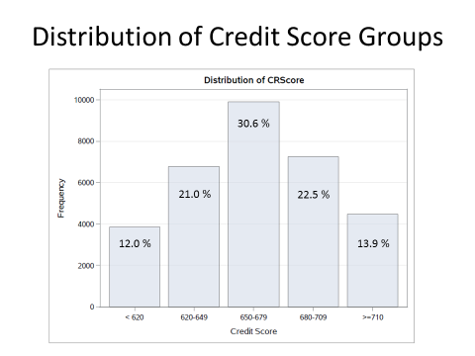
Distribution of Credit Score Groups
Middle
50 %
Mean drifts
by 80 points

Slide 16
Descriptive Analysis : 4-5 slide
Independent Variable(s)
Grouping/Regrouping of variable
Age --- Age Group
Income ----Income Group
Education --- Education Level
Univariate/Bivariate/Multivariate Analysis

Slide 17
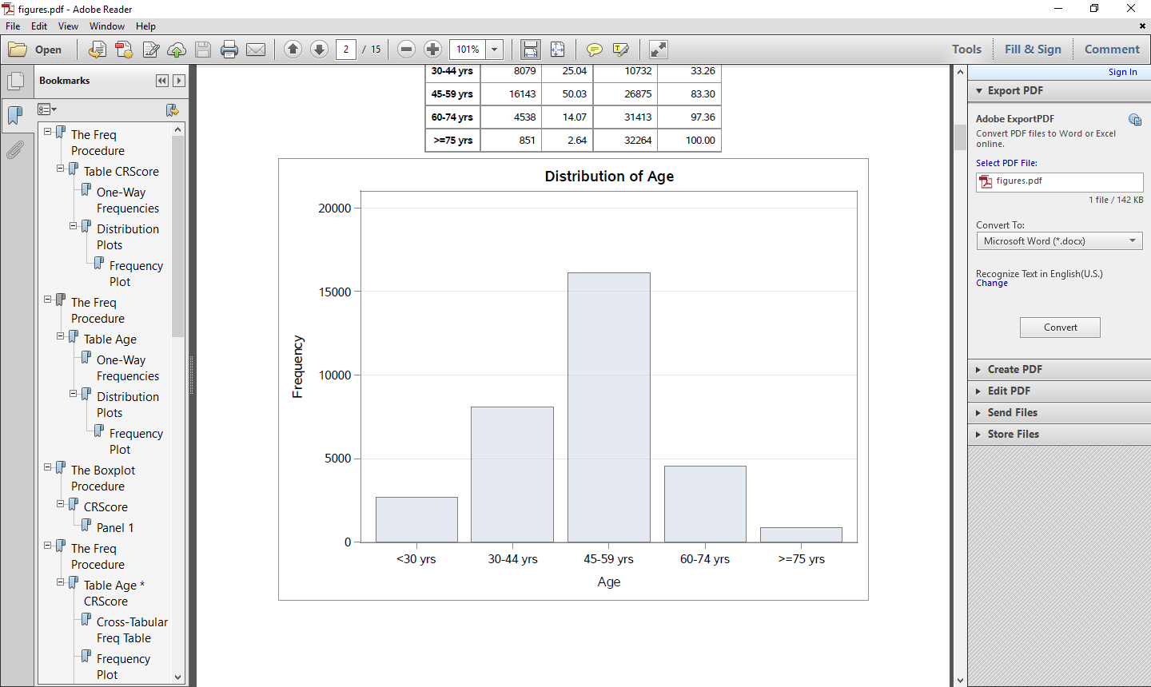
Distribution of Age Groups
50.0 %
25.1 %
14.1 %
8.2 %
2.6 %

Slide 18
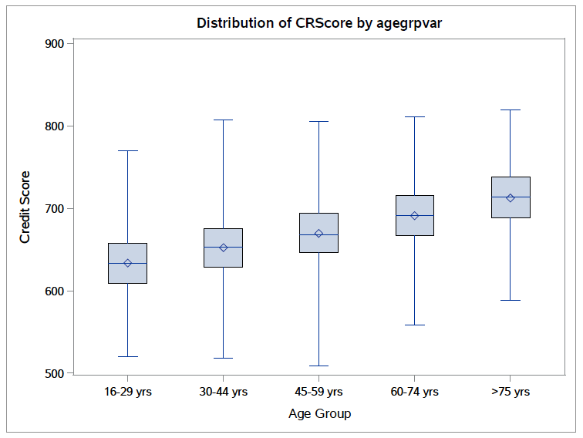
Distribution of Credit Score by Age Group
Middle
50 %

Slide 19
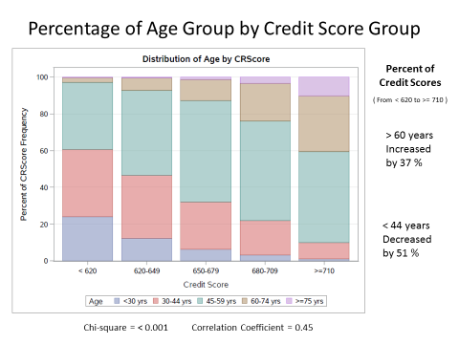

Percentage of Age Group by Credit Score Group

Slide 20
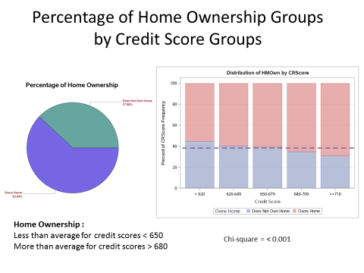
Percentage of Home Ownership Groups by Credit Score Groups

Slide 21
Research Question : 1- 3 slide
Both Inferential and Predictive Analysis
Which variables correlate with credit score?
Any general patterns among credit score groups?
Can credit score be predicted from correlating variable(s)?
Can results predict other correlations?

Slide 22
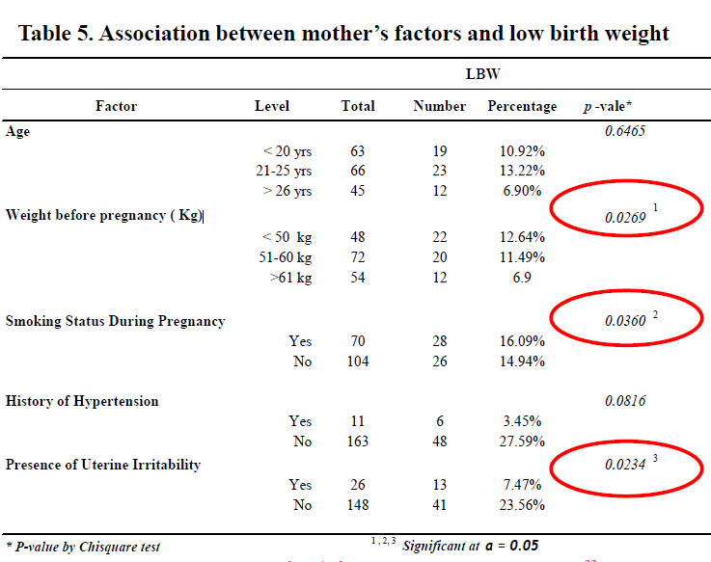
Research Question : 1-2 slide

Slide 23
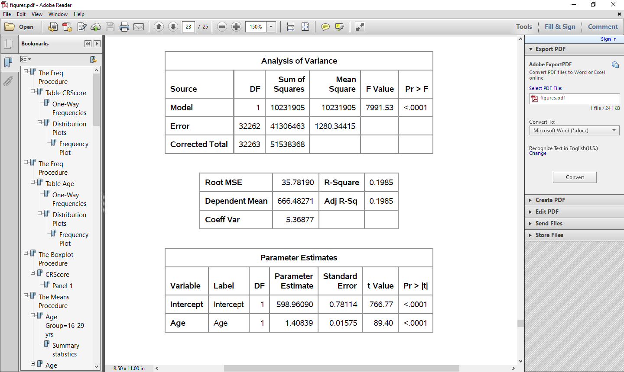
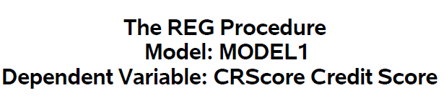
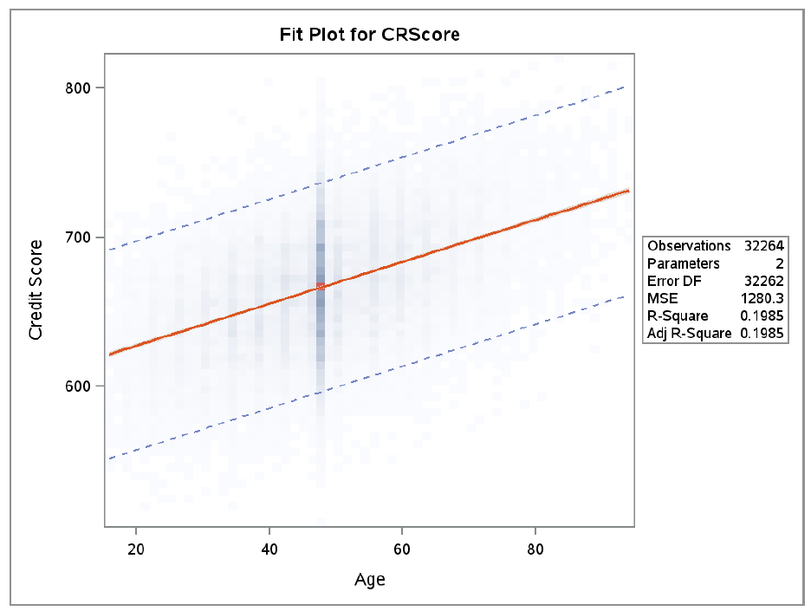
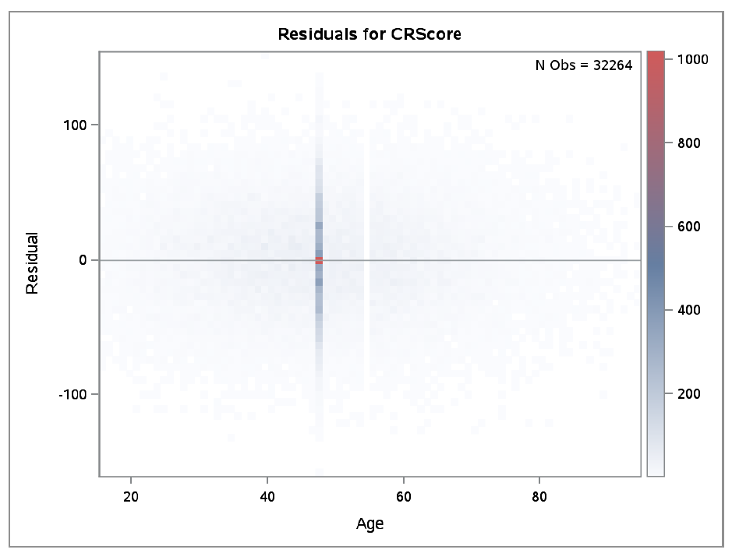
Linear Regression of Credit Score using Age

Slide 24
Conclusions
Results show the following:
  Age and credit score positively correlate
  Length of residence also correlates but less strongly
    Possibly relates to correlation with age
  Home ownership also correlates with credit score
    Predicted by very strong correlation with length of residence
  Customer groups found in major credit score ranges
    Classified mostly by these three variables
  Credit score can be roughly modeled by age using linear regression

Slide 25
Recommendations
For predicting credit risk in population groups:
  Use variables that represent:
    (1) time investment/accumulation (age, length of residence)
    (2) markers of long-term financial stability (home ownership).
  Do not use variables that represent:
    temporary circumstances subject to change yearly or less (residence area, income, checking/saving account balance, etc.).
  For future studies:
    Include multiple years of data to compare changes in credit score to changes in other variables over time.

Slide 26
Appendix
SAS Scripts for Project
/* File Path at Metro */
/* libname will 'C:\Users\wkneewal\project4'; */
/* File Path at Home */
libname will 'C:\Users\William\Documents\SAS Course\SAS Business Project\';
data will.proj4;
set will.project4;
run;
proc contents data = will.proj4;
run;
proc print data = will.proj4(obs = 10);
run;
proc format;
value crscoregrp low-619 ='< 620'
620-649 = '620-649'
650-679 = '650-679'
680-709 = '680-709'
710-high ='>=710';
value agegrp low-29 ='<30 yrs'
30-44 ='30-44 yrs'
45-59 ='45-59 yrs'
60-74 ='60-74 yrs'
75-high ='>=75 yrs';
value loresgrp low-2.4 = '0-2.4 yrs'
2.5-4.9 = '2.5-4.9 yrs'
5.0-7.4 = '5.0-7.4 yrs'
7.5-9.9 = '7.5-9.9 yrs’
10-high = '>=10 yrs';
value hmowngrp 0 = 'Does Not Own Home'
1 = 'Owns Home';
value $resgrp 'R' = 'Residential'
'S' = 'Suburban'
'U' = 'Urban';
run;
proc means data = will.proj4;
var crscore age hmown lores ;
run;
data will.proj4clean;
set will.proj4;
if crscore = . then crscore = 666;
if age = . then age = 48;
if hmown = . then hmown = 1;
if lores = . then lores = 7;
if age < 30 then agegrpvar = '16-29 yrs';
else if 30 <= age < 45 then agegrpvar = '30-44 yrs';
else if 45 <= age < 60 then agegrpvar = '45-59 yrs';
else if 60 <= age < 75 then agegrpvar = '60-74 yrs';
else if age >= 75 then agegrpvar = '>=75 yrs';
label agegrpvar = 'Age Group';
run;
ods graphics on;
/* File Path at Home */
/* ODS pdf file=
'C:\Users\William\Documents\SAS Course\SAS Business Project\figures.pdf';
Title My results; */

Slide 27
Appendix
/* Figure 1 */
proc freq data = will.proj4clean;
table crscore / plots=freqplot;
format crscore crscoregrp.;
run;
/* Figure 2 */
proc freq data = will.proj4clean;
table age / plots=freqplot;
format age agegrp.;
run;
/* Figure 3 */
proc sort data = will.proj4clean out = will.proj4cleanagesort;
by agegrpvar;
run;
proc boxplot data = will.proj4cleanagesort;
plot crscore * agegrpvar;
title 'Distribution of Credit Score by Age Group';
run;
proc means data = will.proj4cleanagesort;
var crscore;
by agegrpvar;
run;
/* Figure 4 */
proc freq data=will.proj4clean;
tables age*crscore / norow nocol
plots=freqplot(twoway=stacked scale=grouppct) chisq;
format crscore crscoregrp. age agegrp.;
title 'Percent of Age Group by Credit Score Group';
run;
proc corr data=will.proj4clean;
var crscore age;
run;
/* Figure 5 */
proc freq data = will.proj4clean;
table lores / plots=freqplot;
format lores loresgrp.;
run;
/* Figure 6 */
proc freq data=will.proj4clean;
tables lores*crscore / norow nocol
plots=freqplot(twoway=stacked scale=grouppct) chisq;
format crscore crscoregrp. lores loresgrp.;
title 'Percent of Residence Length Group by Credit Score Group';
run;
/* Figure 7 */
proc freq data=will.proj4clean;
tables hmown*lores / norow nocol
plots=freqplot(twoway=stacked scale=grouppct) chisq;
format lores loresgrp.;
title 'Percent of Home Ownership by Residence Length Group';
run;
proc corr data=will.proj4clean;
var lores hmown;
run;

